Slide 1
Chapter 15
How to work with arrays, sets, and maps

Slide 2
Objectives (part 1)
Applied
Use arrays in your applications.
Use associative arrays and arrays of arrays in your applications.
Use sets and maps in your applications.
Knowledge
Describe the creation and use of an array.
Describe the use of indexes and the length property for working with an array.
Distinguish between the use of for, for-of, and for-in loops for working with an array.
Describe how destructuring can assign the elements in an array to individual constants or variables.

Slide 3
Objectives (part 2)
Describe these methods of a Array object: push(), pop(), unshift(), shift(), splice(), slice(), indexOf(), lastIndexOf(), includes(), entries(), values(), and keys().
Describe these methods of an array that accept callback function as parameters: find(), findIndex(), filter(), every(), some(), forEach(), sort(), reduce(), map(), and flatMap().
Describe the static Array.isArray() method.
Describe how to split a string into an array.
Describe at least two ways to copy and array.
Distinguish between an array, an associative array, and an array of arrays.
Describe JSON.
Describe how you can convert an array to JSON and back.
Distinguish between an array, a set, and a map.

Slide 4
The syntax for creating an array
Using the new keyword with the Array() constructor
const arrayName = new Array(length);
Using the static Array.of() method
const arrayName = Array.of();
Using an array literal
const arrayName = [];

Slide 5
The syntax for creating an array and assigning values in one statement
Using the new keyword with the Array() constructor
const arrayName = new Array(arrayList);
Using the static Array.of() method
const arrayName = Array.of(arrayList);
Using an array literal
const arrayName = [arrayList];

Slide 6
Examples that create an array and assign values in one statement
Using the Array() constructor
const rates = new Array(14.95, 12.95, 11.95, 9.95);
Using the Array.of() method
const dice = Array.of(1, 2, 3, 4, 5, 6);
Using an array literal
const names = ["Grace", "Charles", "Ada"];

Slide 7
The syntax for referring to an element of an array
arrayName[index]
Code that refers to the elements in an array
rates[2] // Refers to third element in rates array
names[1] // Refers to second element in names array

Slide 8
How to assign values to an array by accessing each element
How to assign numbers to an array that starts with four undefined elements
const rates = new Array(4);
rates[0] = 14.95;
rates[1] = 12.95;
rates[2] = 11.95;
rates[3] = 9.95;
How to assign strings to an array that starts with no elements
const names = [];
names[0] = "Grace";
names[1] = "Charles";
names[2] = "Ada";

Slide 9
A property of an array
length
An operator of an array
delete

Slide 10
How to add an element to the end of an array
const numbers = [1, 2, 3]; // array is 1, 2, 3
numbers[numbers.length] = 4; // array is 1, 2, 3, 4

Slide 11
How to add an element at a specific index
const numbers = [1, 2, 3]; // array is 1, 2, 3
numbers[5] = 6;
// array is 1, 2, 3, undefined, undefined, 6
How to delete a number at a specific index
const numbers = [1, 2, 3]; // array is 1, 2, 3
delete numbers[1]; // array is 1, undefined, 3

Slide 12
How to remove all elements
const numbers = [1, 2, 3]; // array contains 3 elements
numbers.length = 0; // removes all elements

Slide 13
A sparse array that contains 999 undefined elements
const numbers = [1]; // array contains 1
numbers[1000] = 1001; // array contains 1 and 1001
// with 999 undefined elements
// in between

Slide 14
An array that’s used by the following loops
const names = ["Grace", "Charles", "Ada"];
names[5] = "Alan";
// adds two undefined elements between "Ada" and "Alan"
How to use a for loop with an array
The syntax for processing all the elements
for (let index = 0; index < arrayName.length; index++) {
// statements that use the index to access the array // element value
}
Code that uses a for loop
let displayString = "";
for (let i = 0; i < names.length; i++) {
displayString += names[i] + " ";
}
// displayString is Grace Charles Ada undefined undefined Alan

Slide 15
How to use a for-in loop with an array
The syntax
for (const|let index in arrayName) {
// statements that use the index to access the array
// element value
}
Code that uses a for-in loop
let displayString = "";
for (const i in names) {
displayString += names[i] + " ";
}
// displayString is Grace Charles Ada Alan

Slide 16
How to use a for-of loop with an array
The syntax
for (const|let value of arrayName) {
// statements that use the array element value
}
Code that uses a for-of loop
let displayString = "";
for (const val of names) {
displayString += val + " ";
}
// displayString is Grace Charles Ada undefined undefined Alan

Slide 17
The syntax for destructuring an array
const|let [identifier1, identifier2, ...] = arrayName;
Two arrays used by the following examples
const totals = [141.95, 212.25, 411, 135.75];
const fullName = ["Grace", "M", "Hopper"];
Example 1: Assign the first three elements in an array
const [total1, total2, total3] = totals;
// total1 is 141.95, total2 is 212.25, total3 is 411
Example 2: Skip an array element
const [firstName, , lastName] = fullName;
// firstName is "Grace", lastName is "Hopper"

Slide 18
Example 3: Use a default value
const [first, middle, last, suffix = "none"] = fullName;
// first is "Grace", middle is "M", last is "Hopper", // suffix is "none"
Example 4: Use the rest operator to assign some elements to a new array
const[total1, total2, ...remainingTotals] = totals;
// total1 is 141.95, total2 is 212.25, // remainingTotals is [411, 135.75]
Example 5: Destructure a string
const [first, second, third] = "USA";
// first is "U", second is "S", third is "A"

Slide 19
Terms related to arrays
array
element
length
array literal
index
sparse array
destructure an array
rest operator

Slide 20
Methods of the Array type that add, modify, remove, and copy elements
push(element_list)
pop()
unshift(element_list)
shift()
splice(start,number)
splice(start,number, element_list)
slice([start][,end])

Slide 21
A names array that’s by the following examples
const names = ["Grace", "Charles", "Ada"];
Example 1: Add elements to and remove an element from the end of the array
names.push("Alan", "Linus");
// names is ["Grace", "Charles", "Ada", "Alan", "Linus"]
let removedName = names.pop(); // removedName is Linus
// names is ["Grace", "Charles", "Ada", "Alan"]
Example 2: Add and remove an element from the beginning of the array
names.unshift("Linus");
// names is ["Linus", "Grace", "Charles", "Ada", "Alan"]
removedName = names.shift(); // removedName is Linus
// names is ["Grace", "Charles", "Ada", "Alan"]

Slide 22
Example 3: Replace elements from a specific index
names.splice(1, 2, "Mary", "Linus");
// names is ["Grace", "Mary", "Linus", "Alan"]
Example 4: Copy some of the elements of the array to a new array
const partialCopy = names.slice(1, 3);
// partialCopy is ["Mary", "Linus"]
// names array is unchanged
Example 5: Copy all the elements of the array to a new array
const fullCopy = names.slice();
// fullCopy is ["Grace", "Mary", "Linus", "Alan"] // names is unchanged

Slide 23
Methods of the Array type that inspect an array or its elements
indexOf(value[,start])
lastIndexOf(value[,start])
includes(value[,start])
find(function)
findIndex(function)
filter(function)
every(function)
some(function)
entries()
values()
keys()
isArray(object)

Slide 24
A numbers array used by the following examples
const numbers = [1,2,3,4,5,6,7,8,9,10,11,12,13,14,15,16,17,18,19,20];
Example 1: Two ways to check if a specific value is in the array
if(numbers.indexOf(5) != -1) { ... }
if(numbers.includes(5)) { ... }
Example 2: Filter the numbers in the array to get all the values less than 10
const lessThanTen =
numbers.filter( value => value < 10 );
// lessThanTen is [1, 2, 3, 4, 5, 6, 7, 8, 9] // numbers array is unchanged

Slide 25
Example 3: Check if all the numbers in the array are positive
const isAllPos = numbers.every( value => value > 0 ); // isAllPos is true
Example 4: Use a for-of loop with the entries() method
for(let [key, val] of numbers.entries()) {
console.log(`key: ${key}, val: ${val}`);
}
// displays "key: 0, val: 1", "key: 1, val: 2", etc.

Slide 26
Methods of the Array type that transform elements
forEach(function)
join([separator])
toString()
sort([comparison_function])
reverse()
map(function)
reduce(function[,init])
flat([depth])
flatMap(function)

Slide 27
Example 1: Convert the elements in an array to a single string
const names = ["Grace", "Charles", "Ada", "Alan"];
let str = names.join();
// str is "Grace,Charles,Ada,Alan"
str = names.join(", ");
// str is "Grace, Charles, Ada, Alan"
str = names.toString();
// str is "Grace,Charles,Ada,Alan"
Example 2: Sort numeric values in ascending sequence
const numbers = [5, 12, 8, 6, 9, 2];
numbers.sort( (x, y) => x - y ); // numbers is [2, 5, 6, 8, 9, 12]

Slide 28
Example 3: Create a new array with each element multiplied by 2
const doubled = numbers.map( value => value * 2 );
// doubled is [4, 10, 12, 16, 18, 24] // numbers is unchanged
Example 4: Transform the elements and then convert to a single string
const names = ["Grace", "Charles", "Ada", "Alan"];
let str = names.reduce( (prev, current) =>
prev + " " + current.toLowerCase(), "Names:" );
// str is "Names: grace charles ada alan"
Example 5: Flatten an array that’s nested two levels deep
const nested = [5, 12, 8, 6, 9, [4, [0, 7], 1], 2];
const flattened = nested.flat(2);
// flattened is [5, 12, 8, 6, 9, 4, 0, 7, 1, 2]

Slide 29
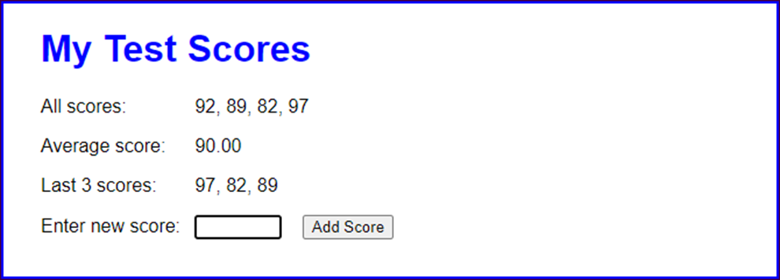
The Test Scores application

Slide 30
The HTML for the Test Scores application (part 1)
<body>
<main>
<h1>My Test Scores</h1>
<div>
<label>All scores:</label>
<label id="all"></label>
</div>
<div>
<label>Average score:</label>
<label id="avg"></label>
</div>
<div>
<label>Last 3 scores:</label>
<label id="last"></label>
</div>

Slide 31
The HTML for the Test Scores application (part 2)
<div>
<label for="score">Enter new score:</label>
<input type="text" id="score">
<input type="button" id="add_score"
value="Add Score">
<span></span>
</div>
</main>
<script
src="https://code.jquery.com/jquery-3.4.1.slim.min.js">
</script>
<script src="test_scores.js"></script>
</body>

Slide 32
The JavaScript for the Test Scores app (part 1)
"use strict";
$(document).ready( () => {
const scores = [];
$("#add_score").click( () => {
const score = parseFloat($("#score").val());
if (isNaN(score) || score < 0 || score > 100) {
$("#add_score").next().text(
"Score must be from 0 to 100.");
}
else {
$("#add_score").next().text("");
// add score to scores array
scores.push(score);
// display all scores
$("#all").text(scores.join(", "));

Slide 33
The JavaScript for the Test Scores app (part 2)
// calculate and display average score
const total =
scores.reduce( (tot, val) => tot + val, 0 );
const avg = total/scores.length;
$("#avg").text(avg.toFixed(2));
// display last 3 scores
const len = scores.length;
const lastScores = (len <= 3) ? scores.slice() :
scores.slice(len - 3, len); // copy last three
lastScores.reverse();
$("#last").text(lastScores.join(", "));
}
// get text box ready for next entry
$("#score").val("");
$("#score").focus();
});
// set focus on initial load
$("#score").focus();
});

Slide 34
A String method that creates an array
split(separator[,limit])
How to split a string that’s separated by spaces into an array
const fullName = "Grace M Hopper";
const nameParts = fullName.split(" "); // creates array
console.log(nameParts.length); // displays 3
console.log(nameParts.toString());
// displays Grace,M,Hopper
const lastName = nameParts[nameParts.length - 1];
console.log(lastName); // displays Hopper

Slide 35
How to split a string that’s separated by hyphens into an array
const date = "1-2-2021";
const dateParts = date.split("-"); // creates an array
console.log(dateParts.length); // displays 3
console.log(dateParts.join("/")); // displays 1/2/2021

Slide 36
How to split a string into an array of characters
const fullName = "Grace Hopper";
const nameCharacters = fullName.split("");
console.log(nameCharacters.length); // displays 12
console.log(nameCharacters.join()); // displays G,r,a,c,e, ,H,o,p,p,e,r

Slide 37
How it works if the string doesn’t contain the separator
const date = "1-2-2021";
const dateParts = date.split("/");
console.log(dateParts.length); // displays 1
console.log(dateParts.join()); // displays 1-2-2021

Slide 38
How to get just one element from a string
const fullName = "Grace M Hopper";
const firstName = fullName.split(" ", 1);
console.log(firstName.length); // displays 1
console.log(firstName[0]); // displays Grace

Slide 39
A static method of the Array type
from(array)
Four ways to make a copy of an existing array
Call the slice() method of the array.
Pass the array to the static from() method of the Array type.
Destructure the array with a rest operator.
Use an array literal with a spread operator and the array.

Slide 40
An array that’s copied by the following examples
const names = ["Grace", "Charles", "Ada"];
How to copy the array
Using the slice() method
const namesCopy = names.slice();
Using the Array.from() method
const namesCopy = Array.from(names);
Using destructuring and the rest operator
const [...namesCopy] = names;
Using an array literal and the spread operator
const namesCopy = [...names];

Slide 41
How to create an associative array with four elements
const item = [];
item["code"] = 123;
item["name"] = "HTML5";
item["cost"] = 54.5;
item["quantity"] = 5;
console.log(item.length); // Displays 0
console.log(Object.keys(item).length); // Displays 4

Slide 42
How to add an element to the associative array
item["lineCost"] =
(item["cost"] * item["quantity"]).toFixed(2);

Slide 43
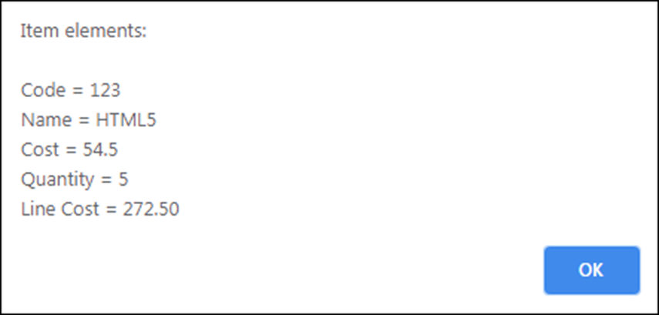
How to retrieve and display the elements in the associative array
alert("Item elements:\n" +
"\nCode = " + item["code"] +
"\nName = " + item["name"] +
"\nCost = " + item["cost"] +
"\nQuantity = " + item["quantity"] +
"\nLine Cost = " + item["lineCost"]);
The message displayed by the alert statement

Slide 44
How to use a for-in loop with the associative array
let result = "";
for (let i in item) {
result += i + "=" + item[i] + " ";
}
// result is "code=123 name=HTML5 cost=54.5 quantity=5 // lineCost=272.50 "

Slide 45
How to create and use an array of arrays
Code that creates an array of arrays
const students = [];
students[0] = [80, 82, 90, 87, 85];
students[1] = [79, 80, 74];
students[2] = [93, 95, 89, 100];
students[3] = [60, 72, 65, 71];
Code that refers to elements in the array of arrays
console.log(students[0][1]); // displays 82
console.log(students[2][3]); // displays 100

Slide 46
How to create and use an array of associative arrays (part 1)
Code that creates an array
const invoice = []; // create an empty invoice array
Code that adds an associative array to the invoice array directly
invoice[0] = [];
invoice[0]["code"] = 123;
invoice[0]["name"] = "HTML5";
invoice[0]["cost"] = 54.5;
invoice[0]["quantity"] = 5;

Slide 47
How to create and use an array of associative arrays (part 2)
Code that creates an associative array and then adds it to the invoice array
const item = [];
item["code"] = 456;
item["name"] = "jQuery";
item["cost"] = 52.5;
item["quantity"] = 2;
invoice.push(item);
Code that refers to the elements in the array of associative arrays
console.log(invoice[0]["code"]); // displays 123
console.log(invoice[1]["name"]); // displays jQuery

Slide 48
More terms related to arrays
spread operator
associative array
arrays

Slide 49
Two static methods of the JSON type
Method Description
stringify(object) Returns a JSON string for the specified object or array.
parse(json) Returns an object or array that contains the data in the specified JSON string.

Slide 50
How to convert an Array object to JSON
// create an array of arrays that stores 2 tasks
const tasks = [];
tasks.push(["Finish current project",
new Date("11/20/2020")]);
tasks.push(["Get specs for next project",
new Date("12/01/2020")]);
// convert array to JSON
const json = JSON.stringify(tasks);
// save JSON to web storage
localStorage.tasks = json;
The JSON for the Array object
[["Finish current project","2020-11-20T08:00:00.000Z"],
["Get specs for next project","2020-12-01T08:00:00.000Z"]]

Slide 51
How to convert JSON to an Array object
// get JSON from web storage
const json = localStorage.tasks;
// convert JSON to array
const tasks = JSON.parse(json);
console.log(tasks[0][0]);
// displays "Finish current project"
console.log(tasks[1][1]);
// displays "2020-12-01T08:00:00.000Z"
// convert JSON string to Date object
const date = new Date(tasks[1][1]);
console.log(date.toDateString()); // displays "Tue Dec 1 2020"

Slide 52
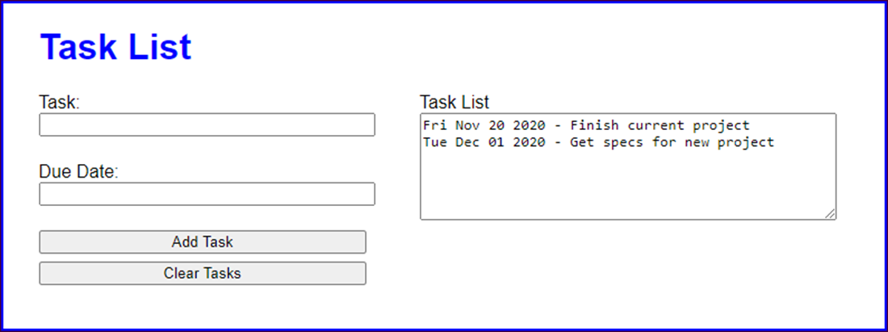
The Task List application

Slide 53
The HTML for the Task List application (part 1)
<body>
<main>
<h1>Task List</h1>
<div id="tasks">
<label for="task_list">Task List</label><br>
<textarea id="task_list" rows="6" cols="50">
</textarea>
</div>
<div>
<label for="task">Task:</label><br>
<input type="text" name="task" id="task">
</div>
<div>
<label for="due_date">Due Date:</label><br>
<input type="text" name="due_date"
id="due_date">
</div>

Slide 54
The HTML for the Task List application (part 2)
<div>
<input type="button" id="add_task"
value="Add Task"><br>
<input type="button" id="clear_tasks"
value="Clear Tasks">
</div>
</main>
<script
src="https://code.jquery.com/jquery-3.4.1.slim.min.js">
</script>
<script src="task_list.js"></script>
</body>

Slide 55
The JavaScript for the Task List app (part 1)
const displayTaskList = tasks => {
let taskString = "";
if (tasks.length > 0) {
// convert stored date string to Date object
tasks = tasks.map( task =>
[task[0], new Date(task[1])] );
tasks.sort( (task1, task2) => { // sort by date
const date1 = task1[1]; // get Date object from task1
const date2 = task2[1]; // get Date object from task2
if (date1 < date2) { return -1; }
else if (date1 > date2) { return 1; }
else { return 0; }
});
taskString = tasks.reduce( (prev, curr) => {
return prev + curr[1].toDateString() + " - " +
curr[0] + "\n";
}, ""); // pass initial value for prev parameter
}
$("#task_list").val(taskString);
$("#task").focus();
};

Slide 56
The JavaScript for the Task List app (part 2)
$(document).ready( () => {
const taskString = localStorage.tasks;
const tasks = (taskString) ? JSON.parse(taskString) : [];
$("#add_task").click( () => {
const task = $("#task").val();
const dateString = $("#due_date").val();
const dueDate = new Date(dateString);
if (task && dateString && dueDate != "Invalid Date") {
// store dateString
const newTask = [task, dateString];
tasks.push(newTask);
localStorage.tasks = JSON.stringify(tasks);
$("#task").val("");
$("#due_date").val("");
displayTaskList(tasks);
} else {
alert("Please enter a task and valid due date.");
$("#task").select();
}
});

Slide 57
The JavaScript for the Task List app (part 3)
$("#clear_tasks").click( () => {
tasks.length = 0;
localStorage.removeItem("tasks");
$("#task_list").val("");
$("#task").focus();
});
displayTaskList(tasks);
});

Slide 58
The syntax for creating a set
const setName = new Set([array]);
A statement that creates an empty set
const emptySet = new Set();
A statement that creates a set from an array
const names = new Set(["Grace", "Charles", "Ada"]);

Slide 59
A property of the Set type
size
Some of the methods of the Set type
add(value)
delete(value)
clear()
has(value)
forEach(function)
entries()
values()
keys()

Slide 60
How to check for values in a set
let hasName = names.has("Grace"); // hasName is true
hasName = names.has("Linus"); // hasName is false

Slide 61
How to add values to a set
let size = names.size; // size is 3
names.add("Linus"); // adds new value to set
size = names.size; // size is 4
names.add("Grace"); // already in set so not added
size = names.size; // size is 4

Slide 62
How to use a set to remove duplicate values from an array
const dupeArray = [4, 6, 2, 3, 2, 3, 4, 7, 6, 8, 9, 2, 8, 2];
const set = new Set(dupeArray);
const noDupes = Array.from(set); // noDupes is [4, 6, 2, 3, 7, 8, 9]

Slide 63
The syntax for creating a map
const mapName = new Map([arrayOfArrays]);
A statement that creates an empty map
const map = new Map();
A statement that creates a map from an array of arrays
const names = new Map( [ ["Grace", "Hopper"], ["Ada", "Lovelace"] ]);

Slide 64
A property of the Map type
size
Some of the methods of the Map type
set(key,value)
get(key)
delete(key)
clear()
has(key)
forEach(function)
entries()
values()
keys()

Slide 65
How to check for a key in the map and retrieve its associated value
if (names.has("Grace")) {
console.log(names.get("Grace"));
// displays "Hopper"
}

Slide 66
How to add key/value pairs to the map
let size = names.size; // size is 2
// add new key/value pair to map
names.set("Charles", "Babbage"); size = names.size; // size is 3
// replace value associated with key
names.set("Grace", "Slick");
size = names.size; // size is 3

Slide 67
How to get arrays of the keys and key/value pairs of the map
const full = Array.from(names);
// full is [["Grace", "Slick"], ["Ada", "Lovelace"],
// ["Charles", "Babbage"]]
const firstNames = Array.from(names.keys());
// firstNames is ["Grace", "Ada", "Charles"]

